Slide 1

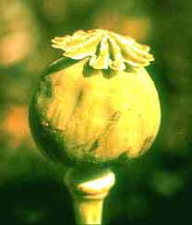

Opioid Analgesics
By Ryan Richards

Slide 2
Overview of Presentation
Pain and the Pain management
Brief History of Opium
Endogenous Opioid Peptides
Chemical Structure and Binding Features of Opioid Analgesics
Types of Opioid Receptors
Types of Opioid Analgesics
The Future of Opioid Analgesics

Slide 3
“The uncomfortable sensation of pain has caused man to seek an explanation, using contemporary concepts to find a reason for this discomfort (1).”
What is Pain?
Pain can be defined as a somatic sensation of acute discomfort, a symptom of some physical hurt or disorder, or even emotional distress.
It is a common human experience therefore the idea of pain and pain management appear throughout history

Slide 4
What is Pain?
Pain is a crucial aspect of the body’s defense mechanisms
Pain “is a part of a rapid warning relay instruction the motor neurons of the central nervous system to minimize detected physical harm (2).”
Pain can be classified into two types

Slide 5
Acute Pain
Acute pain is short-term pain or pain with an easily identifiable cause
Acute pain “is the body's warning of present damage to tissue or disease. It is often fast and sharp followed by aching pain. Acute pain is centralized in one area before becoming somewhat spread out. This type of pain responds well to medications (2).”

Slide 6
Chronic Pain
Chronic pain is pain that last much longer than pain normally would with a particular injury.
Chronic pain can be constant or intermittent and is generally harder to treat than acute pain.
Pain can also be grouped by its source and related pain detecting neurons such as cutaneous pain, somatic pain, visceral pain, and neuropathic pain
Opioid Analgesics can be used to treat many types of pain

Slide 7
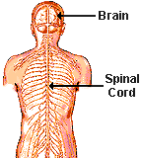
What Causes Pain?
Pain is caused by the stimulation of pain receptors which are free nerve endings.
“Nocireceptors are pain receptors that are located outside the spinal column in the dorsal root ganglion and are named based upon their appearance at their sensory ends. These sensory endings look like the branches of small bushes( 2).”
There are two types of nocireceptors that mediate fast or slow pain signals
The perception of pain is when these receptors are stimulated and they transmit signal to the central nervous system via sensory neurons in the spinal cord.
http://staff.washington.edu/chudler/gif/spiback1.gif

Slide 8
Pain Signaling
These neurons release excitatory neurotransmitters which relay signals from one neuron to another.
“The signals are sent to the thalamus, in which pain perception occurs. From the thalamus, the signal travels to the somatosensory cortex in the cerebrum, at which point the individual becomes fully aware of the pain (2).”

Slide 9
What is Analgesia?
Analgesia simply means the absence of pain without loosing consciousness.
“The analgesia system is mediated by 3 major components : the periaquaductal grey matter (in the midbrain), the nucleus raphe magnus (in the medulla), and the pain inhibitory neurons within the dorsal horns of the spinal cord, which act to inhibit pain-transmitting neurons also located in the spinal dorsal horn. (2)”
These areas are the areas in which the chemical mechanisms of opioid analgesics will take place

Slide 10
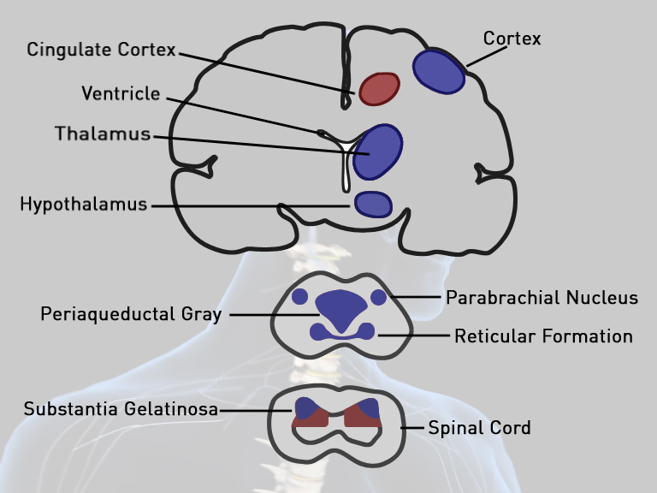
Locations involved in Pain Signaling and Analgesia
http://www.georgiapainphysicians.com/downloads/m1_slides/12.%20opioid%20receptors

Slide 11
History Of Opium
Opiates are one of the oldest types of drugs in history
Undisputed reference to opium found in writings (Theophrastus) from the third century BC
Use of Opium recorded in China and Mesopotamia over 2000 years ago
Greeks dedicated the Opium poppy to the Gods of Death (Thanatos), Sleep (Hypnos), and Dreams (Morpheus)
Sixteenth Century is the first reported use of Opium for its Analgesic qualities
Preparations of opium in the form of elixirs became increasingly popular in the 17th, 18th, and 19th centuries
By the 19th century Opium in various forms was considered “as legitimate as tobacco or tea (3).”

Slide 12
The Opium Wars
Opiates were mainly cultivated in the regions of Persia, India, Malaysia, and China
As the Use of Opium became widespread its trade became a major industry
In the late 18th century the Chinese government puts a ban on opium because of its unwanted and addicting effects
Opium use and trade remains rampant in Southern China primarily with the Dutch East Indian Company
In 1840, Chinese government ceases about 3 millions pounds of opium from British Merchants in an attempt to extinguish opium trade
This results in a series of Wars that ended in 1860

Slide 13

What is an Opioid?
Opioids are drugs derived from or related to the Opium
Opium is derived from the juice of the opium poppy, Papaver somniferum
Opium contains over twenty distinct alkaloids (morphine was the first alkaloid of opium to be isolated in 1806)
By the late 19th century use of these “pure” opium derivatives spread throughout the medical world, however, the method by which these drugs works was unknown.

Slide 14
Endogenous Opioid Peptides
It was not until the 1970’s that research allowed us to understand how the opioid drugs work by studying the endogenous opioid system
In 1973 researchers determined the existence of opiate binding sites in the brain through the use of radioligand-binding assays
In 1975, an endogenous opiate-like factor called enkephalin was found and shortly after this two more classes of endogenous opiate peptides were isolated, the dynophorins and the endorphins.

Slide 15
Endogenous Opioid Peptides
“Endogenous opioid peptides are the naturally occurring ligands for opioid receptors. The term endorphin is used synonymously with endogenous opioid peptides but also refers to a specific endogenous opioid, the Beta-endorphin (4).”
These peptides are produced by the pituitary gland and by the hypothalamus
Opioid peptides are found in the central nervous system mainly in limbic and brainstem areas associated with pain reception, and the certain areas of the spinal cord. Their distribution corresponds to “areas of the human brain where electrical stimulation can relieve pain (4).”

Slide 16
Endogenous Opioid Peptides
These natural peptides work as ligands that interact with their specific receptors causing structural changes that result in other changes in the effected neuron such as the opening or closing of ion gated channels or the activation or deactivation of certain enzymes.
Opioid peptides work by modulating the release and uptake of specific neurotrasmitters in the neurons they are found. This alteration of neurochemical balance creates a vast amount of possible physiological effects, one of which is analgesia.
All of the endogenous opioid peptides are derived from a corresponding precursor proteins and all share a common amino-terminal sequence which is called the “opioid motif.”

Slide 17
The Opioid Receptors
Shortly after the discovery and observance of endogenous opioid peptides, multiple classes of unique opioid receptors were found
There are four main opioid receptors, the mu receptor, the delta receptor, the kappa receptor, and the ORL-1 receptor.
The sigma receptors were once thought to be opioid receptors ,however, pharmacological testing indicated that the sigma receptors were activated by drugs completely unrelated to the opioids
The receptors are found on cell membranes of cells in the nervous system (neurons) and are found in unique distributions and have different effects.

Slide 18
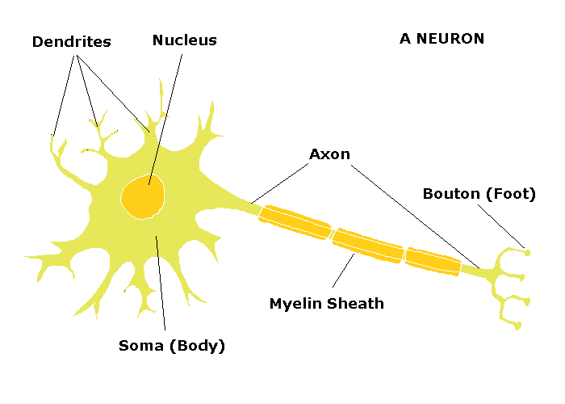
The Anatomy of a Neuron

Slide 19
The μ-receptor
Morphine and its analogues bind most strongly to this receptor and in fact most used opioid analgesic drugs are selective for this specific receptor type.
When and opioid binds to the mu-receptor it produces the effects of analgesia. The mu-receptor is also associated with other effects such as “sedation, reduced blood pressure, itching, nausea, euphoria, decreased respiration, miosis (constricted pupils) and decreased bowel motility often leading to constipation (5).”
When an opioid binds to the mu-receptor it induces a change in shape which in turn induces a change in the ion channels of the associated cell membrane

Slide 20
The μ-receptor
The mu-receptor opens up the ion channel allowing potassium ions to flow out of the cell causing hyperpolarization of the membrane potential. This hyperpolarization causes it to become extremely difficult for an action potential to be reached and therefore the firing of the neuron become far less frequent and the neurons excitability decreases (3).
The release of potassium ions also causes less calcium ions to enter the terminal end of the neuron. This is where neurotransmitters are stored and as a result this significantly reduces neurotransmitter release.

Slide 21
The μ-receptor
These effects of a ligand binding to a mu-receptor essentially turn off the neuron and in doing so block the relaying of pain signals from pain receptors.
They are seen in significant amounts in all areas of the central nervous system associated with pain control
There are two subtypes of the mu-receptor. The μ1-receptors seem to be associated with its analgesic activities and the μ2-receptors seem to be associated with the effects of respiratory depression and constipation.
Respiratory depression is considered the deadly side effect of opioid analgesic drugs. It is the cause of death in all overdose cases.

Slide 22
The κ-receptor
The kappa receptor is very different from the mu-receptor in the fact that there are not many significant agonist of the kappa receptor known
The kappa receptor is associated directly with analgesia and sedation but with none of the undesired side effects associated with the mu receptor.
Because of this, it is an area of focus in current research and shows promise in the development of a safer analgesic.

Slide 23
The κ-receptor
When and agonist or ligand binds to the kappa receptor it induces a conformational change that results directly in the closing of the calcium ion channels in the terminal of the neuron and the neuron can not relay pain messages.
Another difference between the kappa and mu receptors is that the kappa receptors only effect nerves that relay “pain produced by non-thermal stimuli (3),” and mu receptors inhibit all pain signals.
There are three subtypes of the kappa receptor however the difference between these subtypes is not clearly known.

Slide 24
The δ-receptor
The delta receptor is the strongest binding site of the body’s natural pain killer, the class of opioid peptides called the enkephalins.
Morphine and other commonly used opioid analgesics also bind to this receptor strongly and act as an agonist much like they do with the mu receptor.
The delta receptor is a G-protein linked receptor. When an agonist binds to the delta receptor is induces a conformational change that causes the activation of a specific G-protein.

Slide 25
The δ-receptor
This G-protein “inhibits the membrane bound enzyme adenylate cyclase and prevents the synthesis of cAMP. The transmission of the pain signal requires cAMP to act as a secondary messenger, and so inhibition of this enzyme blocks the signal ( 3).”
The delta receptor is found in larger cells than the other receptors and seems to be important in spinal analgesia.

Slide 26
The ORL-1 receptor
the ORL-1 receptor or the “orphan” receptor was very recently discovered.
The natural opioid peptide that is a ligand for this receptor is nociceptin which is also called orphanin.
The ORL-1 receptor is associated with many different biological effects such as memory processes, cardiovascular function, and renal function.
It is thought to have effects on dopamine levels and is associated with neurotransmitter release during anxiety.

Slide 27
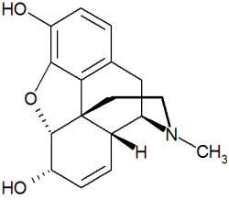
Structure of Opioids
In order to examine important structural features of Opioid analgesics, which are all derived from the opiate structure, we will refer to the structure of morphine, the first identified alkaloid.

Slide 28
Structure of Opioids
The structure of morphine consists of five rings forming a T-shaped molecule
The important binding groups on morphine are the phenol, the aromatic ring, and the ionized amine. These groups are found in all Opioid analgesics.
. “A free phenol group is crucial for analgesic activity (3).” The aromatic ring of the opiate also seems to be integral to its function as compounds that lack the aromatic ring show no analgesic activity. The ionized amine also plays an important role in its activity and is common in opioid structure. In experiments where the Nitrogen was replaced by a Carbon no analgesic activity was found. It interacts with certain analgesic receptors in its ionized form.

Slide 29
Binding of Opioids
. Before specific opioid receptors were discovered in 1973 by the means of new autoradiographic techniques, it was unknown exactly how the opiate alkaloids interacted to produce the physiological effects associated with the drugs.
It was assumed that Opioids binding to a single, rigid, analgesic receptor.
The Beckett-Casy Hypothesis proposed a method of binding of Opioid drugs to this receptor

Slide 30
The Beckett-Casy Hypothesis
Positively charged nitrogen group of opioid will form an ionic bond with anionic group of receptor
In order to accomplish this “there must be a basic nitrogen group which is then ionized at physiological pH for form a positively charged group (3),’ because the positively charged group could not cross the blood brain barrier.
This would result in the opioids having a pKa of around 7.8 to 8.9, which is consistent with all opioid analgesics

Slide 31
The Beckett-Casy Hypothesis
The hypothesis also proposes van der Waals interaction between the aromatic ring and a hydrophobic region of the binding site
This suggests a close spatial relationship between the aromatic ring of the opioid and the surface of the binding site

Slide 32
The Beckett-Casy Hypothesis
The hypothesis also suggests hydrogen bonding with the phenol group of the opioid and the receptor binding site
It also proposes that the receptor possesses a unique structural feature that allows the ethylene bridge of the opioid to snugly fit into the binding site and in doing so properly aligning the rest of the molecule with the associated binding regions.

Slide 33
The Beckett-Casy Hypothesis
Although the discovery of multiple unique opioid receptors in 1973 violated the assumption of the hypothesis that there was a single, rigid binding site. The binding mechanisms proposed remain valid possible interactions
It is evident that the phenol group, the ionized amine, and the aromatic ring are very important structural features of the opioids.

Slide 34
MORPHINE
Morphine is the golden standard among opioid analgesics to which the structure and strengths of all other drugs are compared
It is the primary ingredient in opium and was isolated in 1806
Morphine has strong binding affinity for the mu and delta opioid receptors and some weak affinity for the kappa receptor

Slide 35
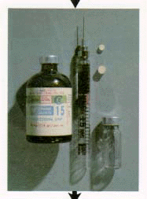
MORPHINE
Morphine is administered in subcutaneous, intravenous or epidural injections or orally in the form of a solution (however this form is far less potent).
Morphine acts extremely fast and crosses the blood brain barrier quickly but is not as fast acting lipid-soluble opioids such as codeine or heroin.

Slide 36
Morphine Metabolism
Once morphine is administered about one third of it become bound to proteins in the plasma
The major pathway for the metabolism of morphine is conjugation with glucoronic acid (5).”
Two metabolites are formed from this conjugation which cross the blood brain barrier. Morphine-6-glucuronide seems to be the metabolite responsible for the associated interactions of morphine with the opioid receptors.

Slide 37
Side Effects of Morphine
Side effects of morphine include a depression of cough due to respiratory depression, nausea caused by increased vestibular sensitivity, and decreased gastric motility and some constipation.
Morphine use is also thought to be associated with some cases of renal failure as well as acute pancreatitis.

Slide 38
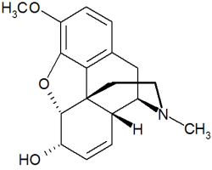
Codeine
Codeine is also an alkaloid that is found in opium but to a far lesser extent than morphine.
It differs structurally from morphine in that its phenol group is methylated. It is often referred to as methyl-morphine.

Slide 39
Codeine
Oxycodone and methadone are analogs of codeine
Codeine itself has low binding affinity to all of the opioid receptors. Its analgesia producing effects come from its conversion to morphine.
When codeine is administered about ten percent is converted to morphine by O-demethylation that occurs in the liver by an enzyme called cytochrome p450.
Because of this Codeine is far less potent than morphine

Slide 40

Codeine
Codeine is usually administered orally and it is much more effective orally than morphine (about 60%)
Because of the side effect of respiratory depression and depressed cough, codeine is often found in cough medicines

Slide 41

Abuse of Codeine
The use of Codeine as a recreational drug for its euphoric effects is spreading greatly.
This abuse is mostly isolated to Texas
Recreational users refer to codeine as “lean” and will mix the drug with alcohol or other drugs.

Slide 42
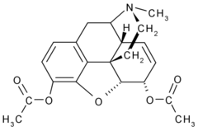
Heroin
Heroin is diacetylmorphine produced from the acetylation of morphine.
Heroin was first synthesized in 1874.
Although Heroin is illegal, it is still legally prescribed, mostly in terminal patients, as diamorphine.

Slide 43
Heroin
Heroin is mostly found in a white crystalline form diacetylmorphine hydrochloride.
It is administered through intravenous injections but can also be administered orally or vaporized.
It binds most strongly to the mu receptor and is also active in the form of morphine as its acetyl groups are removed.
It produces euphoric effects similar to morphine, however, it is thought that these effects are greater and more addicting because of its extremely rapid effect.
Its fast action is a result of being extremely lipid-soluble because of its acetyl groups and therefore it immediately crosses the blood brain barrier.

Slide 44

Heroin
The use of Heroin causes the body to produce far less of its natural opioid peptides, the endorphins. This creates a dependence on heroin.
When a heroin user stops using the drug the withdrawal symptoms are severe.
Withdrawal symptoms include anxiety, depression, cramps, vomiting, diarrhea, restless leg syndrome (hence kicking the habit), and a severe sense of pain caused by nothing.
Many addicts in withdrawal experience “itchy blood” which can drive the addict to scratch cuts and bruises into his body.

Slide 45
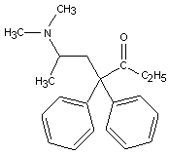
Methadone
Methadone is often used to treat heroin addiction because it is a longer lasting opioid.
It has a half life of 24 to 48 hours compared to 2 to 4 hours found with morphine and codeine.
It is an analog of codeine and it was first synthesized in 1937.

Slide 46

Other Opioid Analgesics
Many other opioid analgesics exists and are currently being developed that our based from the common opiate structure
These drugs have differences in their substituents that changes their effects and methods of action at their receptors

Slide 47
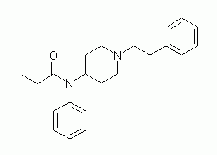
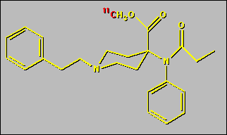
Other Opioid Analgesics
Fentanyl is about 1000 times stronger than morphine.
Carfentanil is about 10,000 more times more potent than morphine (It is used as a tranquilizer for large animals)

Slide 48
Opioid Antagonists
Opioid Antagonists are used to treat opioid overdose cases.
Most are derived from Thebaine (an alkaloid of Opium)
The have strong binding affinity for the mu receptors
They work by competitive inhibition at the binding site (It binds but does not change the receptor while at the same time blocking the agonist).

Slide 49
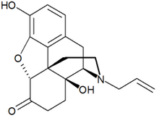
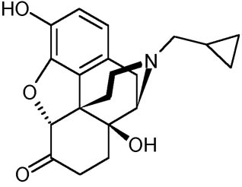
Opioid Antagonists
Naloxone is an example of a opioid antagonist.
It is administered intravenously.
It can rapidly produce the withdrawal symptoms associated with opioid addiction.
Naltrexone is another example of an opioid antagonist. It is more potent than Naloxone and is used in the treatment of alcohol addiction but its mechanism in this treatment is unknown.

Slide 50
Future of Opioid Analgesics
The future of Opioid Analgesics seems to be linked to the study of the Kappa Receptor. The kappa receptor induces analgesia without the dangerous and unwanted side effects that the mu and delta receptors are associated with. However there are not any selectively strong agonists to this receptor as of now.

Slide 51
Future of Opioid Analgesics
Another area of research important to the future of opioid analgesics is the study of the endogenous opioid peptides.
Because these peptides are endogenous, on metabolic degradation (unlike opiates) they break down to amino acids. Hence, the metabolites are nontoxic and to not cause kidney and liver damage (6).”
Also, because they are made from amino acid residues, “a large number of analogs can be synthesized from a few basic building blocks and simple modifications may be attempted to develop analogs with a desired biological effect (6).”
The further study of the endogenous opioid peptides seems to be integral to development of new safer drugs.

